Slide 1
THE ROLE OF PARTISANSHIP IN THE BATTLE WITH COVID-19
Talk Data to Me

Slide 2


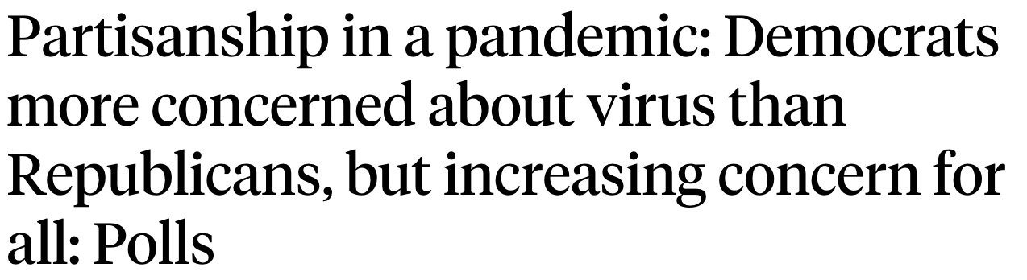
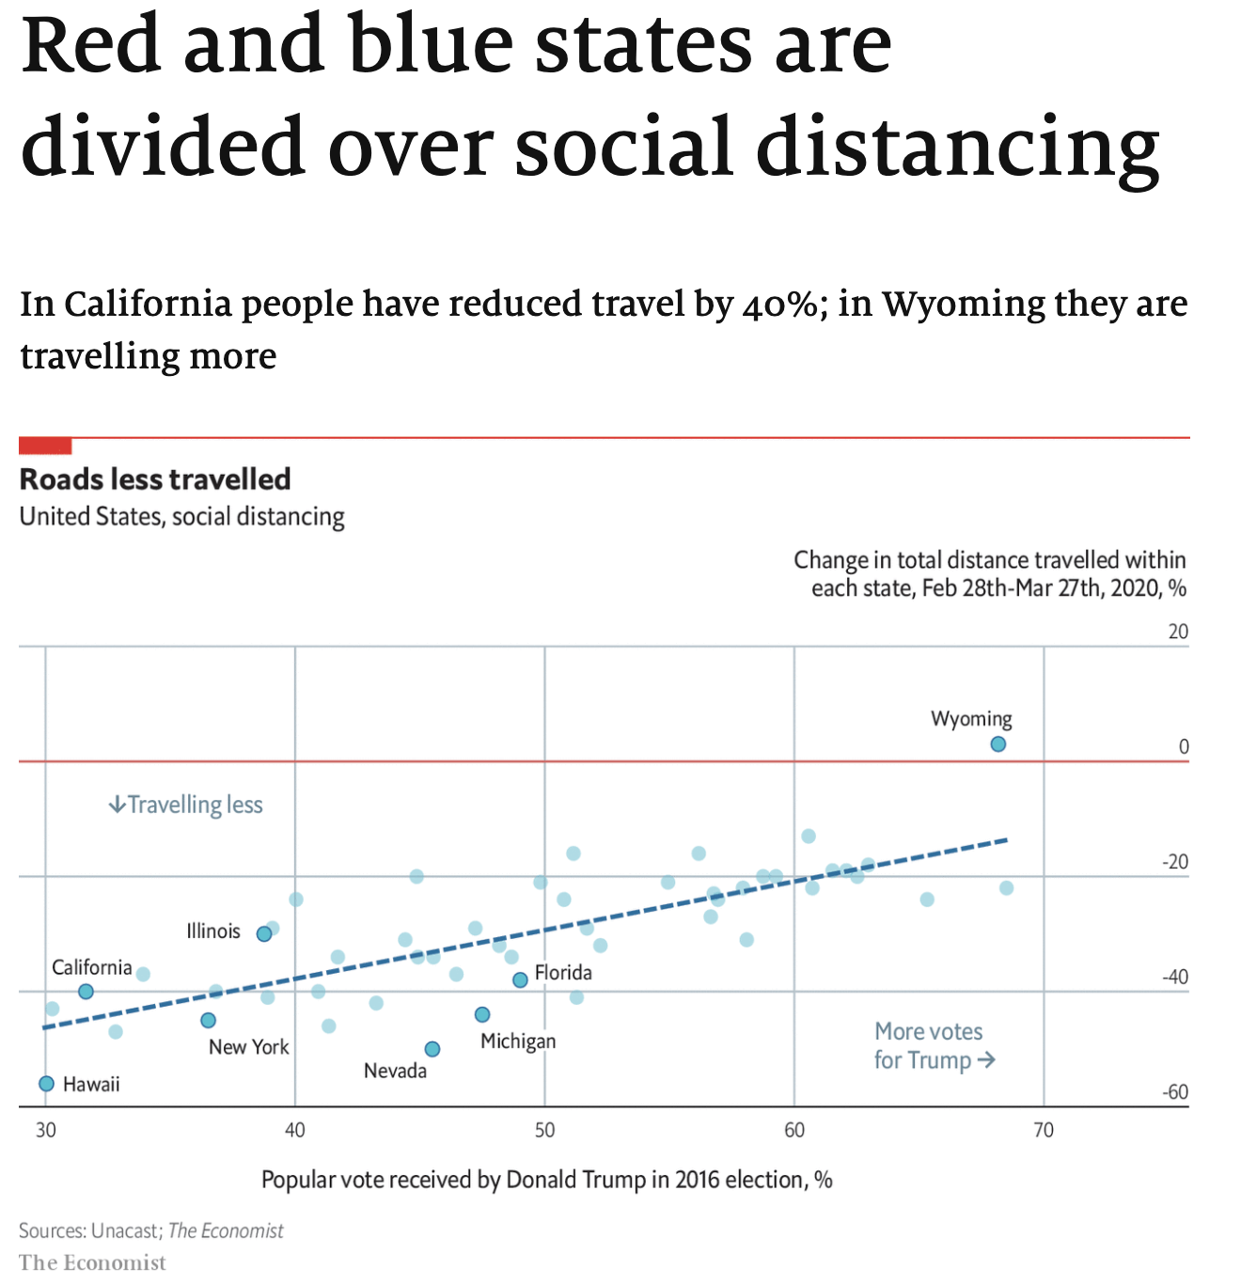

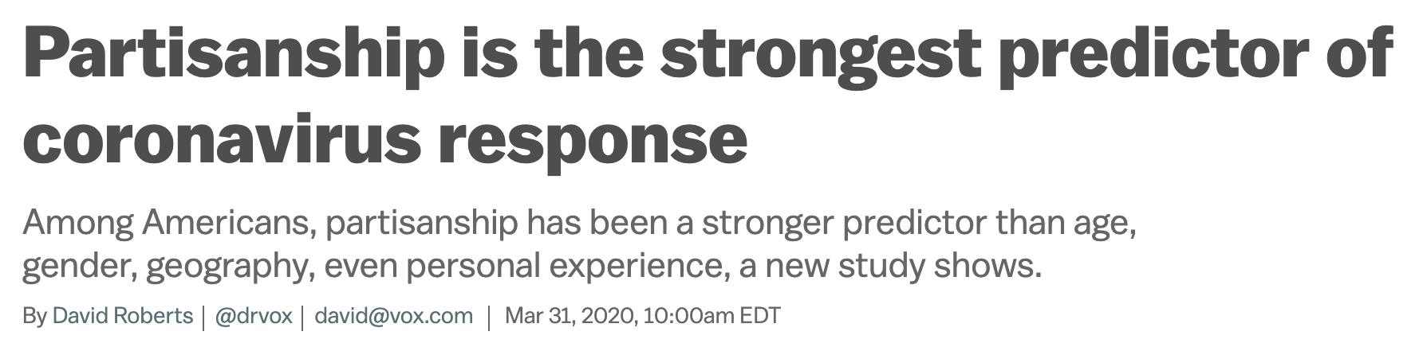
What has the media been telling us?

Slide 3
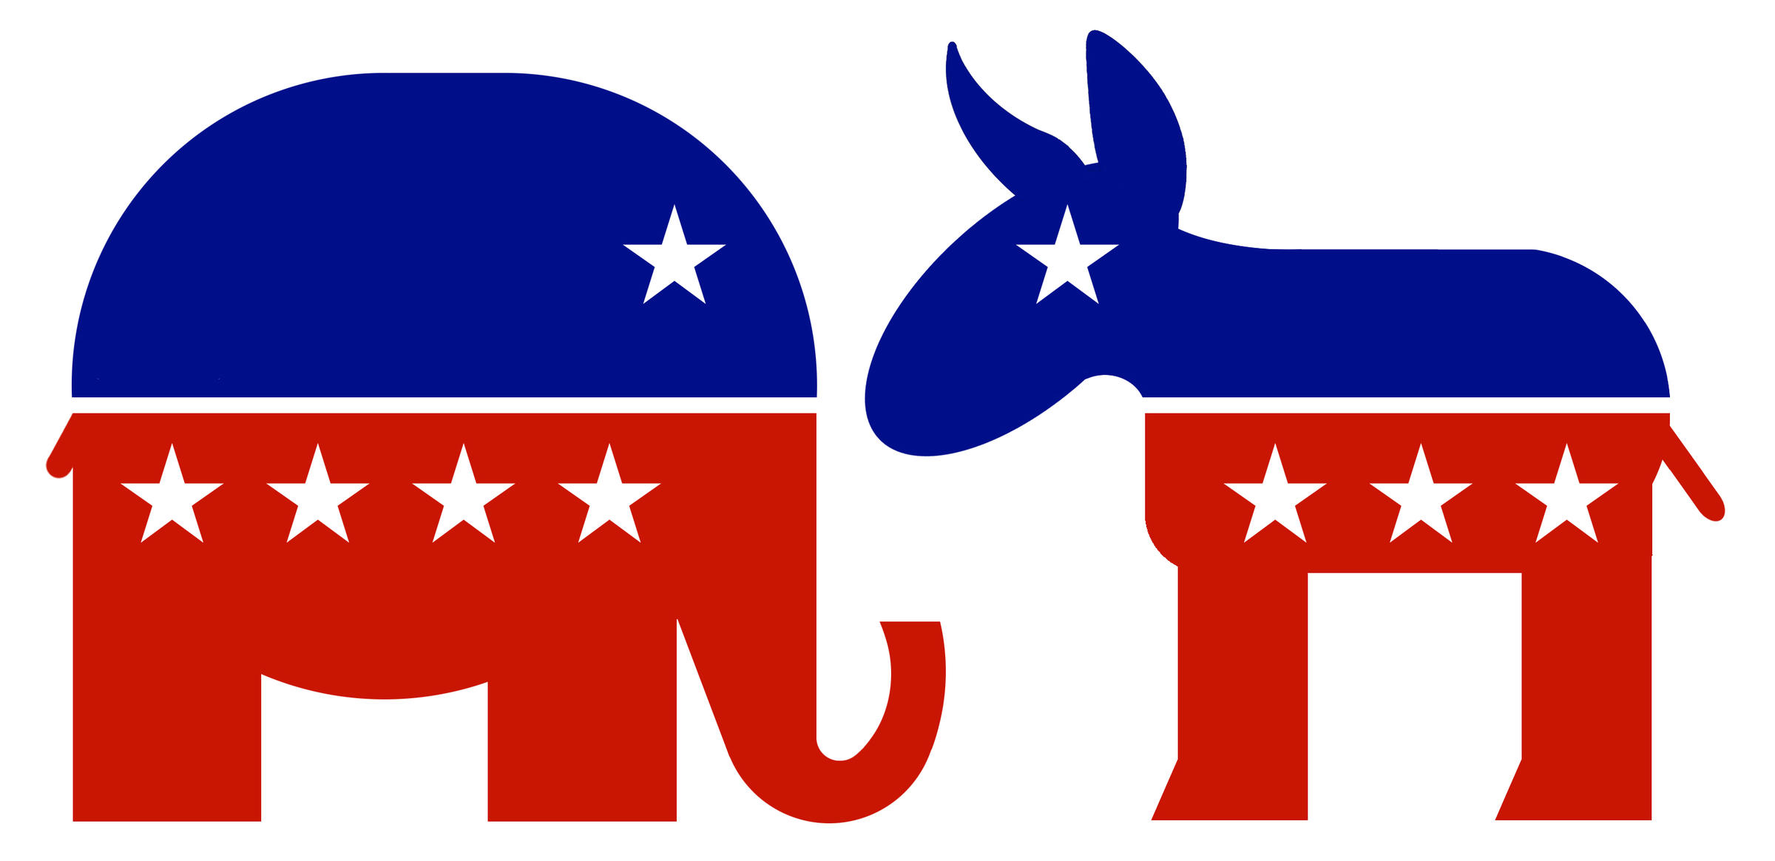
Let’s dig into the data
+2 infected population /day
When comparing Republican to Democratic states
Average 27 infected population / day
Data sources: John Hopkins CSSEGISandData, World Population Review

Slide 4
How Democratic states differ from Republican states?
Government Interventions
Public Awareness
Community Mobility

Slide 5
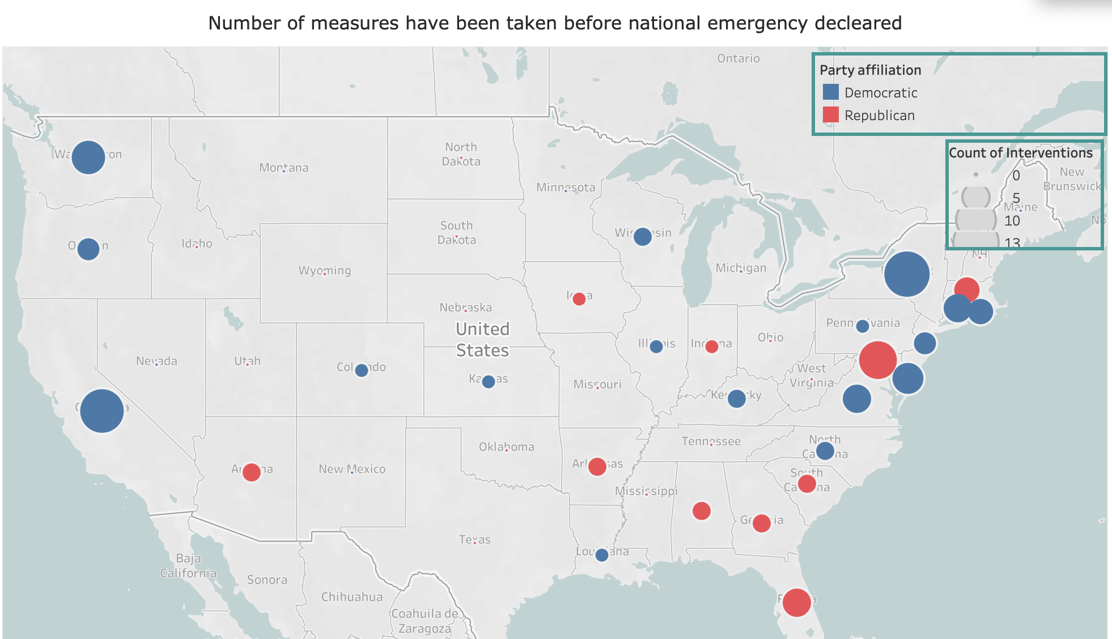
Government Intervention
Blue states took 28% more interventions than Red states
13 Blue states declared state of emergency vs. 5 Red states
Data Source: University of Oxford Project

Slide 6
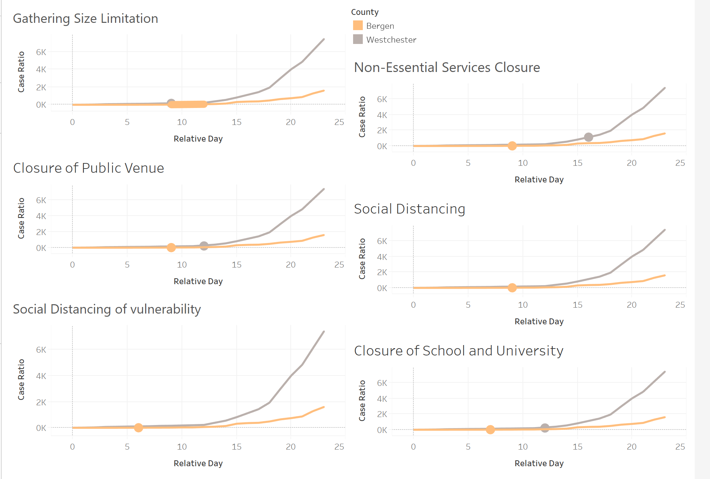


How much do interventions matter?
Bergen
Westchester
Intervention
Similar demographic attributes
Parallel trend before the intervention
Similar COVID-19 outbreak date
Time lag for all interventions
Data Source: Keystone Strategy

Slide 7
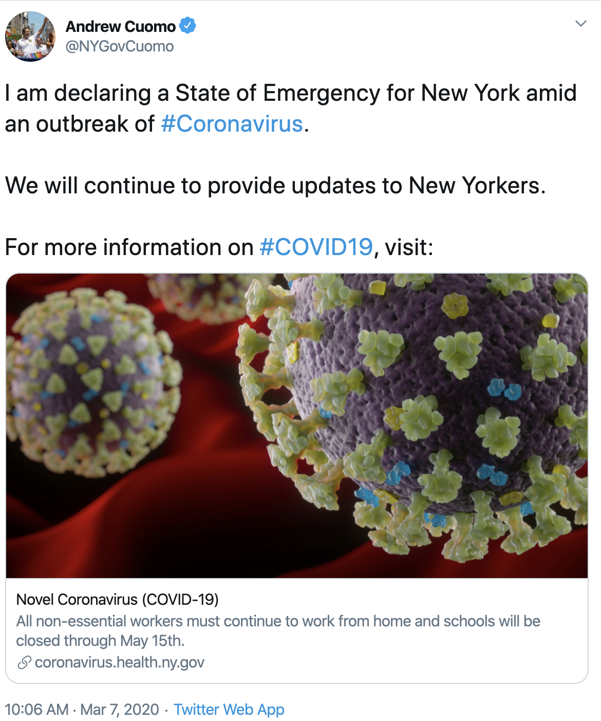

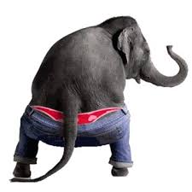
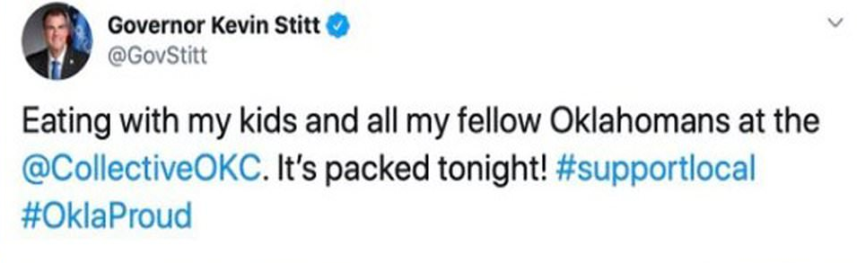

What is the Donkey Saying?
What is the Elephant saying?

Slide 8

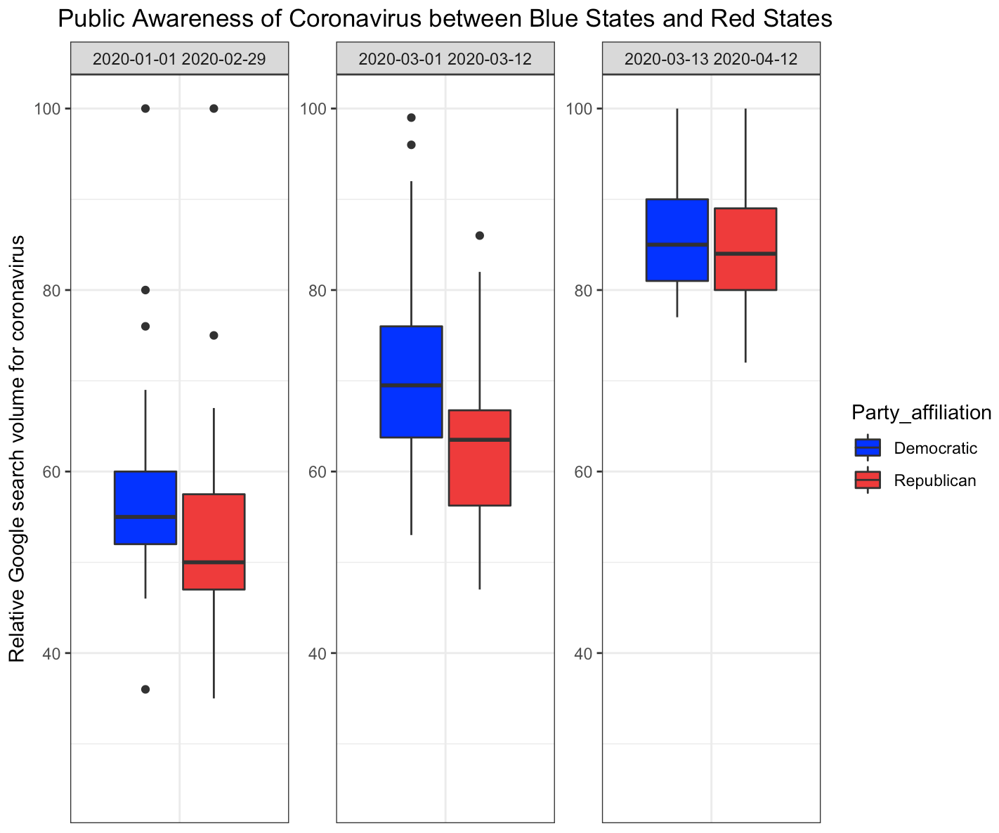

Its effect on public awareness
Search terms:
Coronavirus,
N-95 mask,
Hand Sanitizers
Statistical difference in early outbreak period
Data sources: Google Search Trends

Slide 9
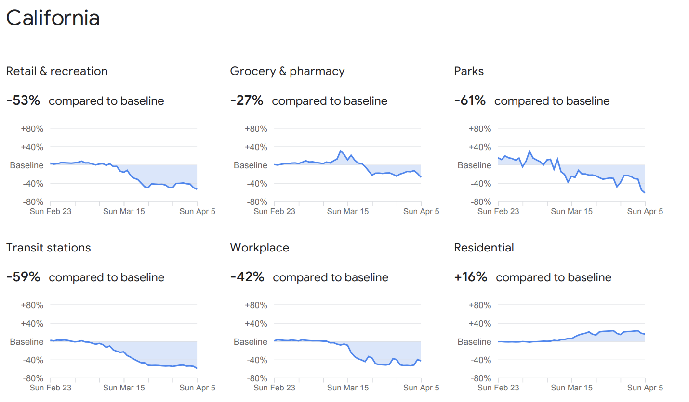
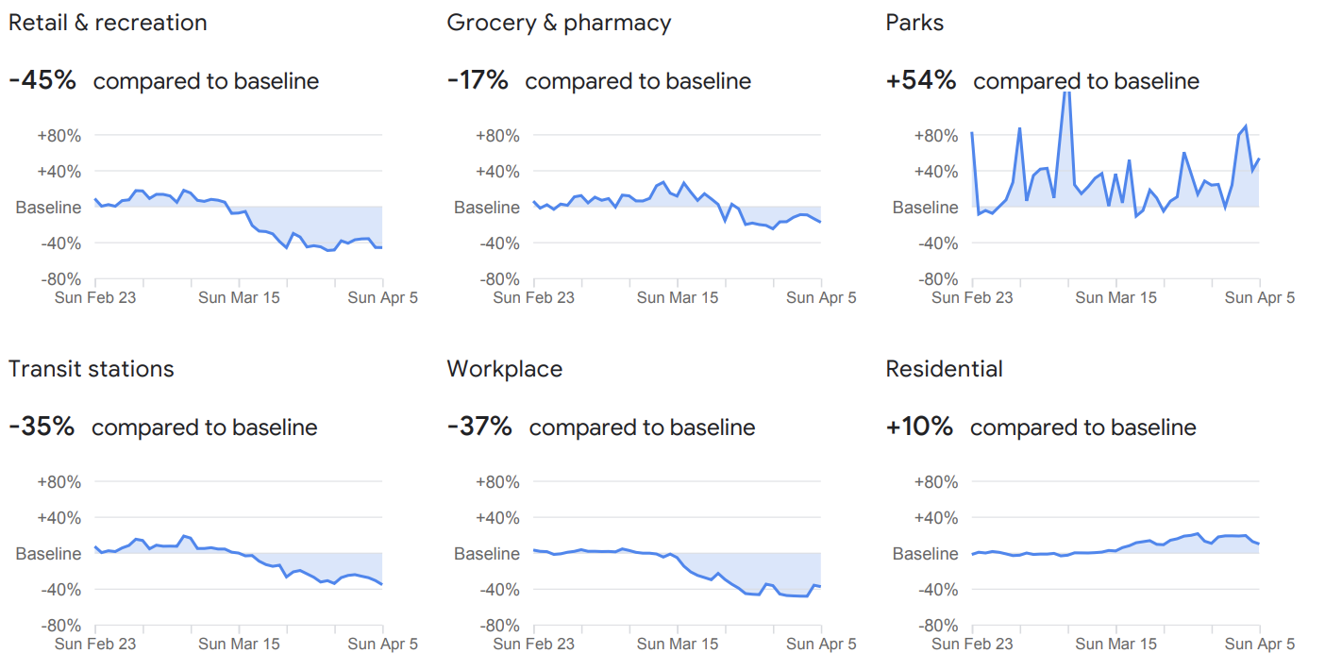
How do interventions and awareness come into play?
California
130 cases / 1M
VS.
Indiana
250 cases / 1M

Slide 10
Could that difference be a fluke?
-0.9 decrease in new cases/day can be achieved as a result of 1 p.p decrease in mobility compared to the baseline
(Average new cases/day is 3.67)
Data sources: John Hopkins CSSEGISandData, World Population Review, Google Community Mobility Report

Slide 11
The path from partisanship to the spread
Partisanship
Intervention
COVID-19 Severity
Mobility
Public Awareness

Slide 12
What does the data tell us?
A state’s public awareness and government intervention is dependent on its political leaning.
Government intervention plays an important role in containing the spread.
Reduced mobility is effectively reducing severity.

Slide 13

The crisis calls for a collective response from both the Democratic and Republican Party

Slide 14

Thank You

Slide 15
DATA SOURCES
Party Affiliation 2018 Midterm Election Result
County-level Measures Keystone Strategy
State-level Measures University of Oxford Project
Social Awareness Google Search Trends
Mobility Google Community Mobility Report
Population World Population Review
Time-Series Cases John Hopkins CSSEGISandData

Slide 16
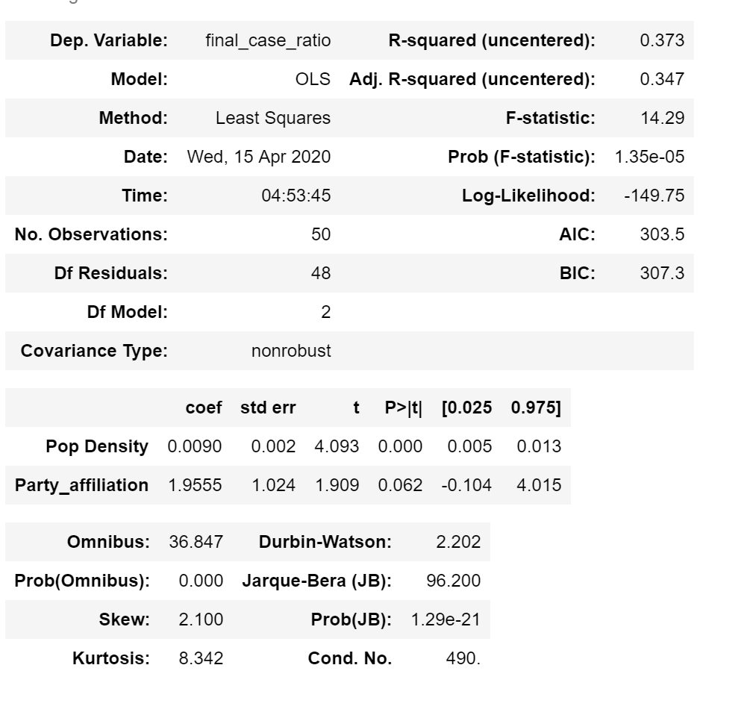
APPENDIX 1
Severity of the Covid-19 breakout between Blue States and Red States

Slide 17
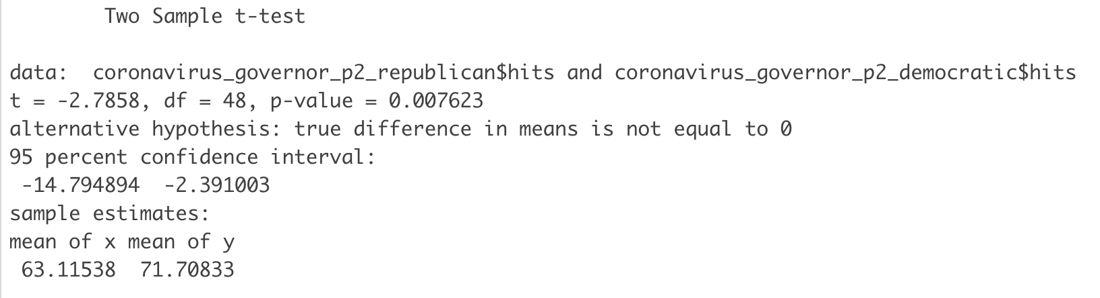
APPENDIX 2
Significant difference exists between Blue States and Red States during early outbreak of Covid-19

Slide 18
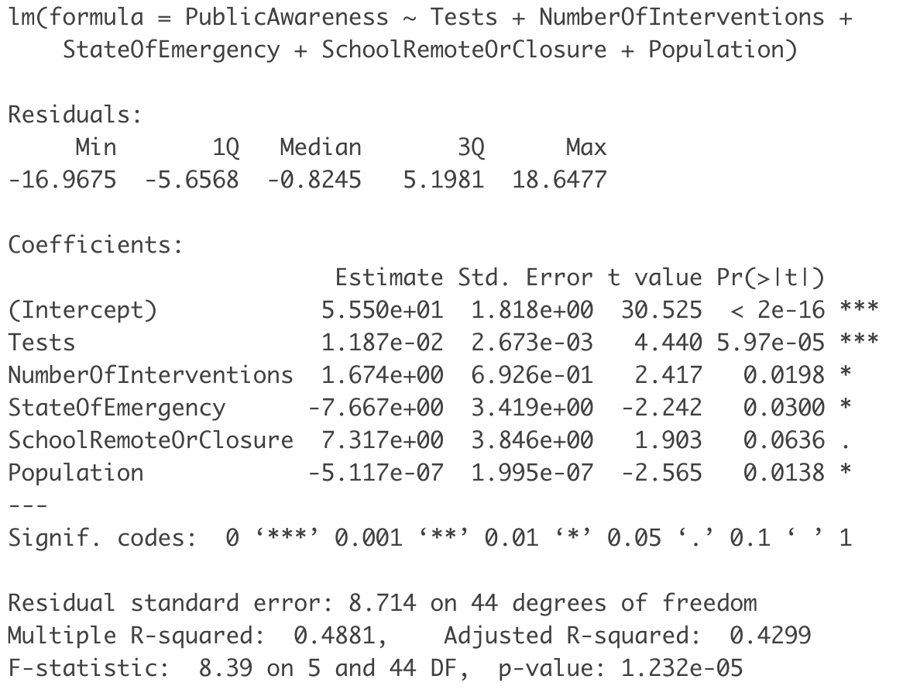
APPENDIX 3
Regress public awareness on interventions while control for number of tests and population by state

Slide 19
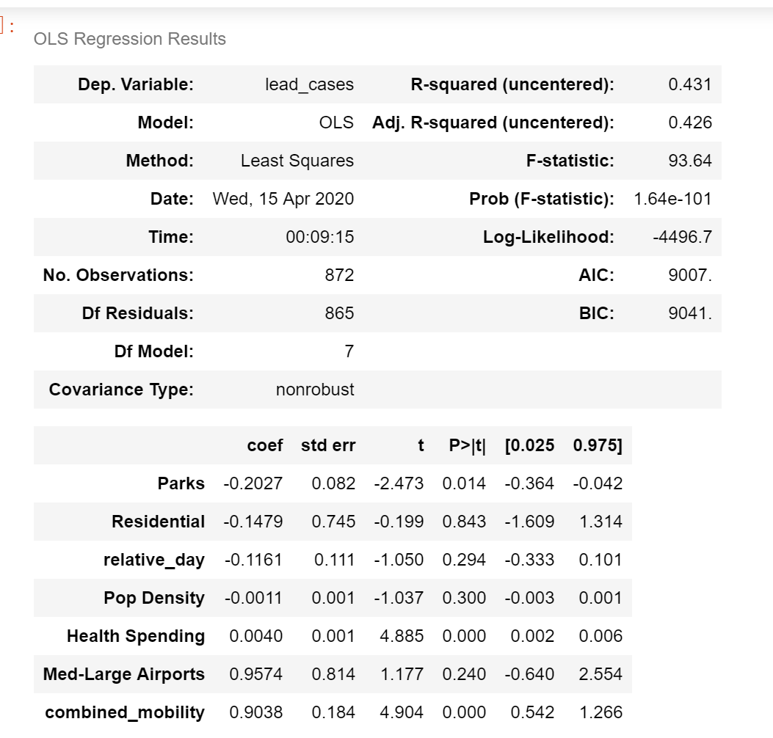
APPENDIX 4
Regress social mobility on lead cases while control for number state demographics

